Slide 1
Occupancy Modelling CSP4141
Introduction to Multi- Season-
Single Species Occupancy Model
Wednesday, May 23nd, 2018
National Conservation Training Center Course
May 21st - 25th, 2018
Columbia River Fisheries Program Office

Slide 2
Occupancy Review
S sampling units are selected to be sampled for a species.
Units are closed to changes in occupancy during a common ‘season’
Units are repeatedly sampled within a season
*Units may be sampled over multiple seasons to monitor temporal changes in occupancy
Notes:
The assumption of the single-season model is that the sites are closed to changes of the occupancy state during the sampling interval. That is, if we survey sites three times, the assumption is that site does not go extinct (if it is occupied), and does not get colonized (if it is empty) between the first sampling session and the third sampling session.

Slide 3
Multi-season
In many cases we are very interested in changes in occupancy patterns. The multi-season occupancy model is a natural extension of the single season occupancy model used for:
monitoring programs
estimating metapopulation parameters
Notes:
However, in many cases we are very interested in changes in occupancy patterns. For instance, metapopulation theory is based on changes in occupancy patterns of patches over time. In this case, we may want to estimate the probability that an empty site will be colonized, and probability that an occupied site goes extinct.
The Multi-Season Occupancy Model specifically deals with these issues. Likewise, we might be interested not in a metapopulation but a single population but a snapshot of the population, which is what a single season occupancy model provides, does provide information of patterns and processes that we may be interested in.
The best way to understand a processes occurring within a system is to observe how the sytem behaves over a longer timeframe, such as multiple seasons or years.

Slide 4
Dynamics of Occupancy
What is a “season”?
A season is a period of time during which it is reasonable to assume occupancy is static or changes occur completely at random.
Depends very much on the target species and study objectives.
Is there a natural definition? (e.g., a breeding season)
How mobile is the species?

Slide 5
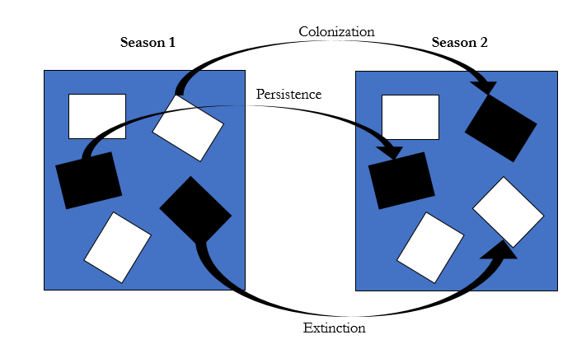
Dynamics of Occupancy
(filled represents occupied site)
Notes:
Many metapopulation studies investigate a system wimilar to shown here. Where researchers are interested in the processes of local extinction and colonization. This process is sometimes referred to in terms of the incidence function. Most of these, however, don’t explicitly account for detection probability.

Slide 6
Multi-Season Occupancy
Major differences between the structure of a SS and MS model:
1) Detection histories
2) Addition of 2 new parameters, γ (colonization probability) and ε (extinction probability)

Slide 7
How to Model Multi-Season Data?
1) Fit a single-season occupancy model to each season’s data
Ignores dynamic structure and potential information when same units are surveyed over time
Potential for temporal autocorrelation, which violates the independence assumption
2) Fit a multi-season (dynamic) occupancy model where the dynamic processes of occupancy are explicitly considered
Notes:
There are two general approaches for modeling changes in occupancy over time.
The first is to use a model where underlying dynamics are implied but not explicitly accounted for (effectively combining several single-season models)

Slide 8


Option 1
Can introduce structure to model systematic changes in occupancy, i.e., trends in occupancy
Does not model the dynamic processes of occupancy; local-extinctions and colonizations
$$logit\left(ψ_{t}\right)=α+β_{t}$$
Notes:
In this approach, you model the detection/nondetection data from multiple seasons by applying a single season model to the dat. Occupancy in one season is considered to be a random process in the sense that the occupancy status of a unit in the previous season has no effect on the probability of occupancy at the units in the current season. This approach disregards the underlying process of change in occupancy.

Slide 9
How to Model Multi-Season Data?
1) Fit a single-season occupancy model to each season’s data
2) Fit a multi-season (dynamic) occupancy model where the dynamic processes of occupancy are explicitly considered
Incorporates a form of temporal autocorrelation in occupancy status of units
Notes:
The 2nd method which we’ll focus on, is to explicitly model potential changes in the occupancy state of a unit over time by estimating extinction and colonization probabilities.

Slide 10
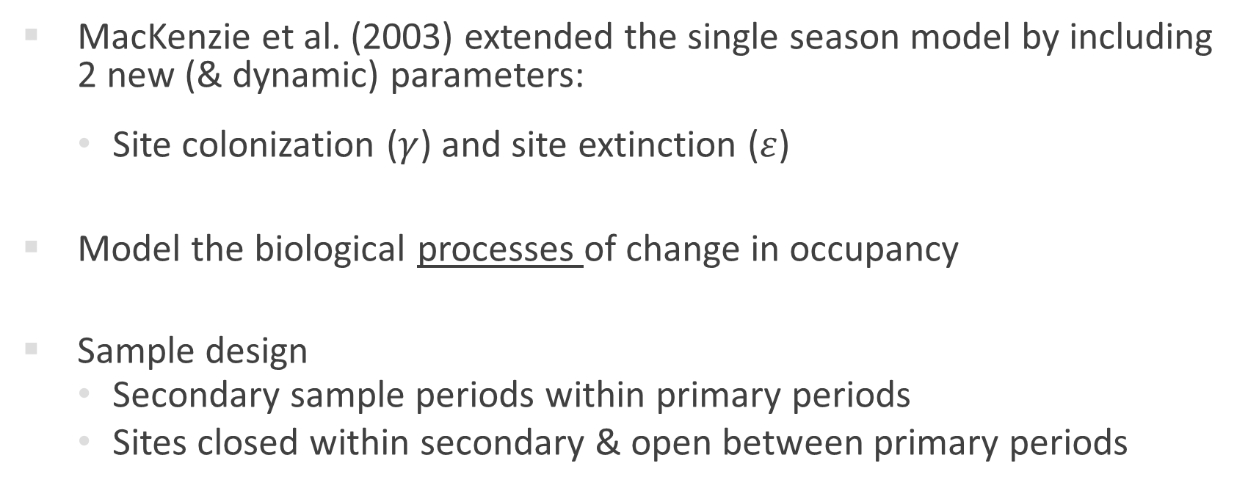
Option 2
MacKenzie et al. (2003) extended the single season model by including 2 new (& dynamic) parameters:
Site colonization ($γ$) and site extinction ($ε$)
Model the biological processes of change in occupancy
Sample design
Secondary sample periods within primary periods
Sites closed within secondary & open between primary periods
Notes:
The dynamic processes governing changes in the occupancy state variable are the colonization of an unoccupied unit by the species and the local extinction of the species at an occupied unit.
These are somewhat analogous to birth rate and death rate processes of the abundance state variable and likewise, supply information relevant to the ong-term sustainability of a population.

Slide 11
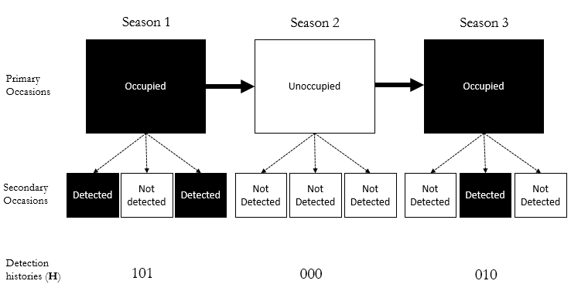
Survey Data Structure
Notes:
Let's assume that we survey a site in May as we've done in the past. The site is visited and a 1 is recorded if a species was detected, otherwise a 0 is recorded. The site is then visited again two more times under the assumption of closure. So, three surveys were conducted in the first primary period. From the data collected in that period, we can
estimate the parameters ψ, p1, and p2 – just like the standard occupancy model.

Slide 12
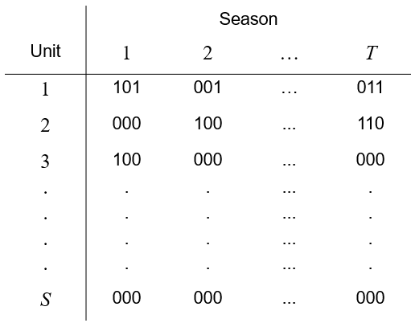
Survey Data Structure
Notes:
Now let's assume that we repeat this process 1 month later (June), under the assumption that the occupancy pattern of the sites may have changed between months. Again, we survey the site two times and record a 1 if an animal was detected and a 0 if it was not. So we have two primary periods (May and June), and within each primary sampling period the site was surveyed three times and the population is assumed to be closed. However, we now assume that the population is open between the primary periods. That is, the species can go locally extinct, and the species can colonize previously unoccupied patches/sites between the first primary period and the second primary period.

Slide 13
Multi-season Model Parameters
y₁ = probability a site is occupied by the species in season 1
e_{t} = probability a site becomes unoccupied by the species between seasons t and t+1
g_{t} = probability a site becomes occupied between seasons t and t +1
p_{t,j} = probability the species is detected at a site in survey j of season t (given presence)

Slide 14
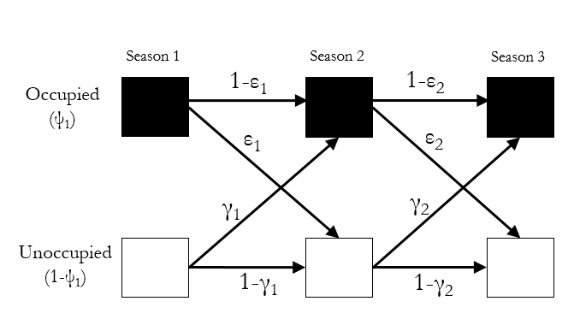
Multi-season Model Parameters
Notes:
Ψ₁ = probability a site is occupied by the species in season 1
ε_{t} = probability a site becomes unoccupied by the species between seasons t and t+1
γ_{t} = probability a site becomes occupied between seasons t and t +1
p_{t,j} = probability the species is detected at a site in survey j of season t (given presence)

Slide 15
Multi-season Model
Complication: Incomplete detection
Variability in detection can be related to a variety of factors:
Weather
Physical habitat characteristics
Local animal abundance
Species-specific differences
In short…things that can also affect occupancy dynamics

Slide 16
Multi-season Model
Example detection history 1,
Verbal description: the species was present at the unit in season 1, where it was detected in first and third surveys, but not detected in the second survey. Between seasons, species persisted (did not go locally extinct) but was never detected in season 2
OR…the species went locally extinct between seasons 1 and 2

Slide 17
Multi-season Model
Another example detection history,
Verbal description: the species was present in season 1, but never detected, persisted (did not go locally extinct) between seasons, and was detected in the second survey during season 2.
OR…the species was absent in season 1, colonized the unit between seasons, and was detected in the second survey during season 2.

Slide 18

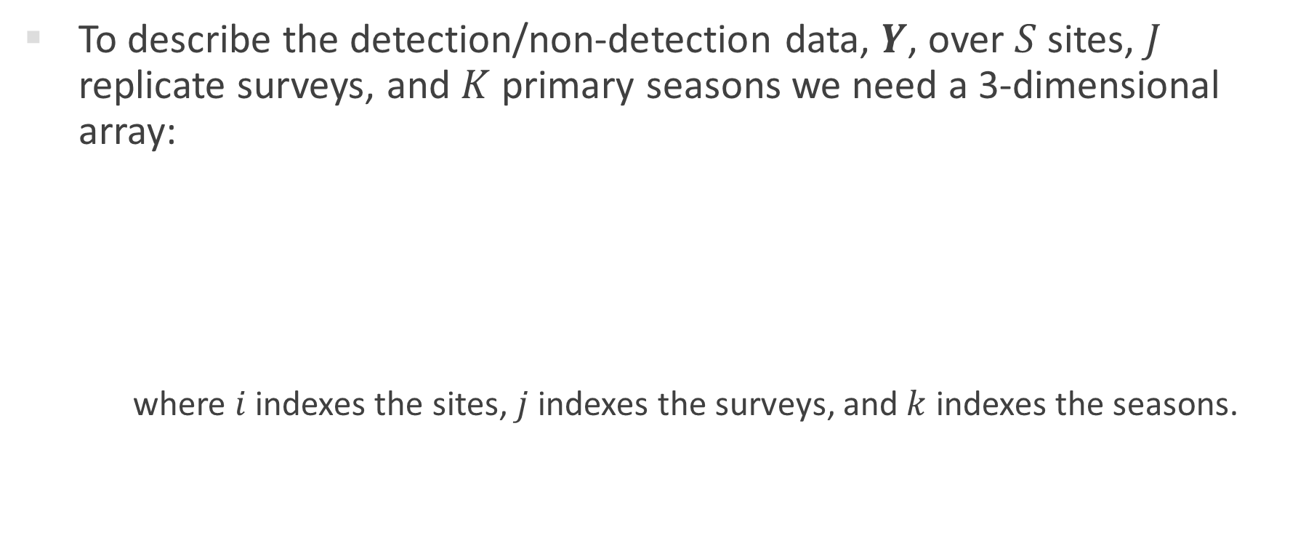
Hierarchical Structure
To describe the detection/non-detection data, $Y$, over $S$ sites, $J$ replicate surveys, and $K$ primary seasons we need a 3-dimensional array:
where $i$ indexes the sites, $j$ indexes the surveys, and $k$ indexes the seasons.
$$Y=y_{i,j,k}$$

Slide 19

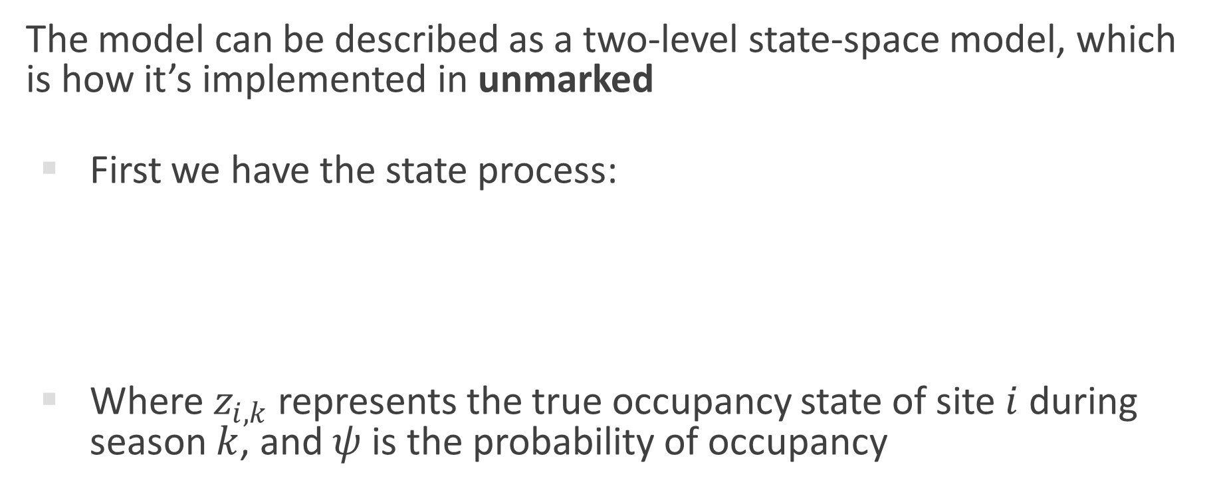
Hierarchical Structure
The model can be described as a two-level state-space model, which is how it’s implemented in unmarked
First we have the state process:
Where $z_{i,k}$ represents the true occupancy state of site $i$ during season $k$, and $ψ$is the probability of occupancy
$$z_{i,k}\sim Bernoulli(ψ_{i,k})$$

Slide 20

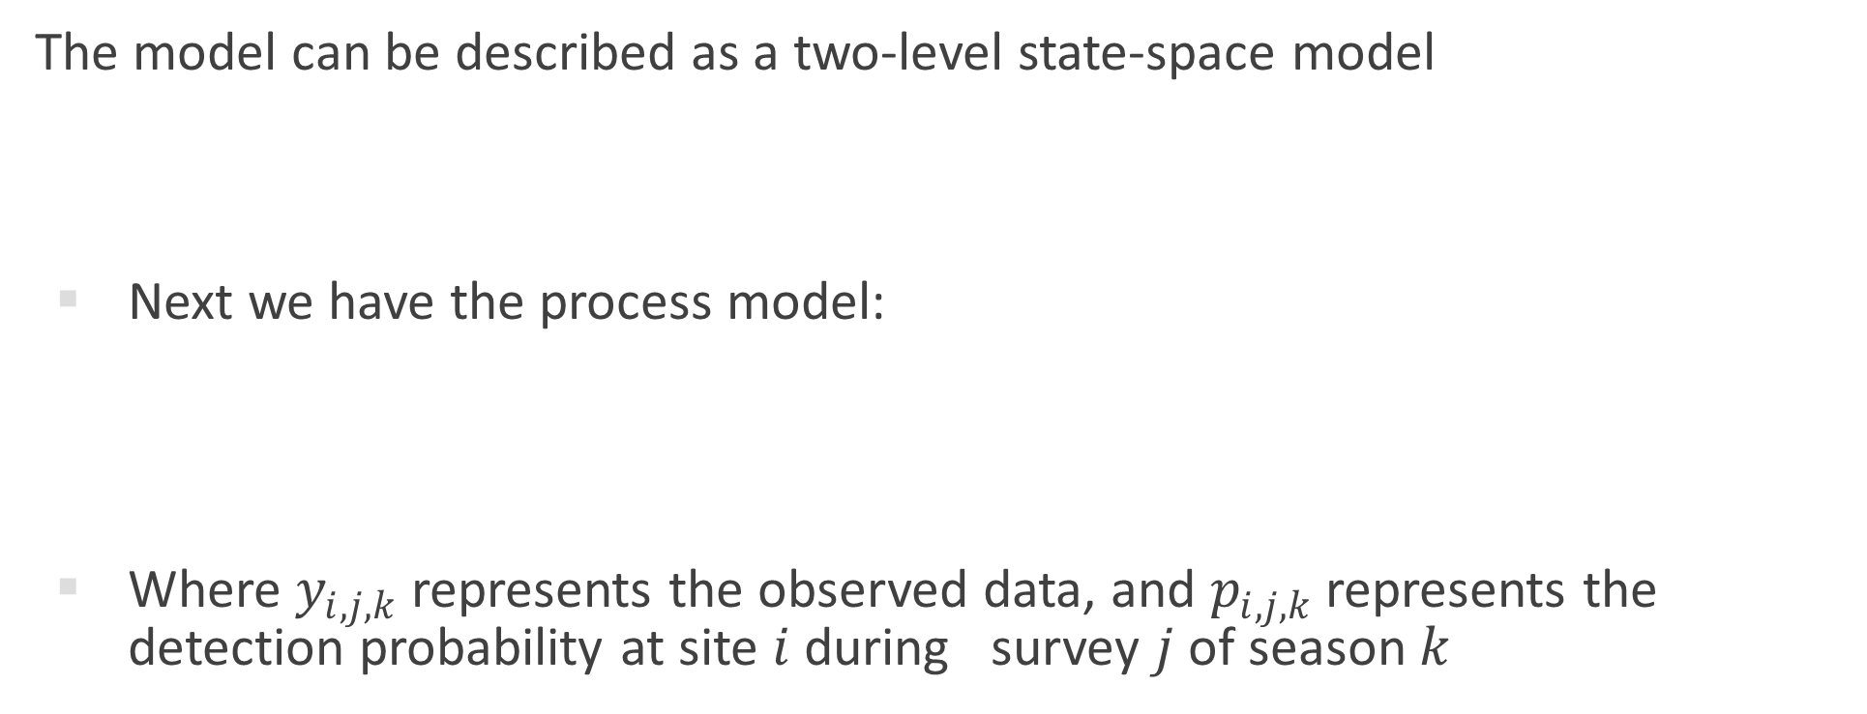

Hierarchical Structure
The model can be described as a two-level state-space model
Next we have the process model:
Where $y_{i,j,k}$ represents the observed data, and $p_{i,j,k}$ represents the detection probability at site $i$ during survey $j$ of season $k$
$$z_{i,k}\sim Bernoulli(ψ_{i,k})$$
$$y_{i,j,k}\sim Bernoulli(z_{i,k}∗p_{i,j,k})$$

Slide 21

Hierarchical Structure
At this point we could fit a single season occupancy with an index for season (recall Option 1).
However, we can also now add dynamics:
For season 1, our state model remains the same:
For each additional season we can explicitly model the occupancy state transitions:
$$z_{i,1}\sim Bernoulli(ψ_{i,1})$$
$$z_{i,k+1}\sim Bernoulli(z_{ik}∗{(1−ε}_{i,k})+\left(1−z_{i,k}\right)∗γ_{i,k})$$

Slide 22
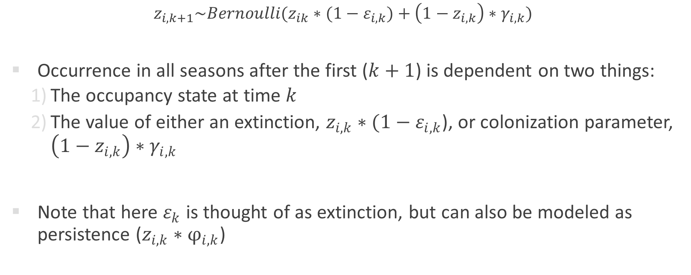
Hierarchical Structure
${ z}_{i,k+1}\sim Bernoulli(z_{ik}∗{(1−ε}_{i,k})+\left(1−z_{i,k}\right)∗γ_{i,k})$
Occurrence in all seasons after the first ($k+1$) is dependent on two things:
The occupancy state at time $k$
The value of either an extinction, $z_{i,k}∗(1−ε_{i,k}$), or colonization parameter, $\left(1−z_{i,k}\right)∗γ_{i,k}$
Note that here $ε_{k}$ is thought of as extinction, but can also be modeled as persistence ($z_{i,k}∗φ_{i,k}$)

Slide 23
Multi-season Model
Various programs are available for fitting multi-season occupancy models (and variants; see next slide).
MARK/RMARK
PRESENCE/RPRESENCE
Unmarked
BUGS/JAGS

Slide 24
Summary
Multi-season occupancy is useful for:
Evaluating trends in occupancy over time
Estimating meta-demographic parameters: extinction and colonization
Evaluating influence of abiotic/biotic factors on meta-demographic parameters
Evaluating biological hypotheses

Slide 25
Summary
Can be extended to other types of occupancy models:
Multiple-states
Multiple-species
Multiple-scales

Slide 26
Follow-along exercise
See rMarkdown file

